Slide 1
Analyzing Amazon Sales Data
Amit Patil

Slide 2
Problem Statement
Objective
Benefits
Gain insights into sales trends
Improve business performance
Increase customer satisfaction.
Increase customer satisfaction.
Reduce costs
Stay competitive
Enable data-driven decision-making
The objective of this project is to extract, transform, and load Amazon sales data into a database, analyze the data to identify sales trends, key metrics, and factors influencing sales, and develop recommendations for improving sales performance. The project aims to provide insights into sales performance to help stakeholders make data-driven decisions and improve overall sales performance
In today's highly competitive e-commerce industry, it is essential for businesses to have an effective sales management strategy to increase profits and reduce costs. However, without proper data analysis, it can be challenging to gain insight into customer behaviour, market trends, and other factors that impact sales performance.

Slide 3
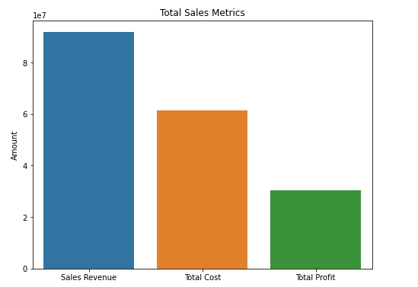
1 .Bar Chart for Sales Revenue, Cost, and Profit
This chart shows the total sales revenue, cost, and profit for the company. The chart
will have three bars representing the sales revenue, cost, and profit, with the amounts
displayed on the y-axis and the categories on the x-axis. The title of the chart will be
"Total Sales Metrics."

Slide 4
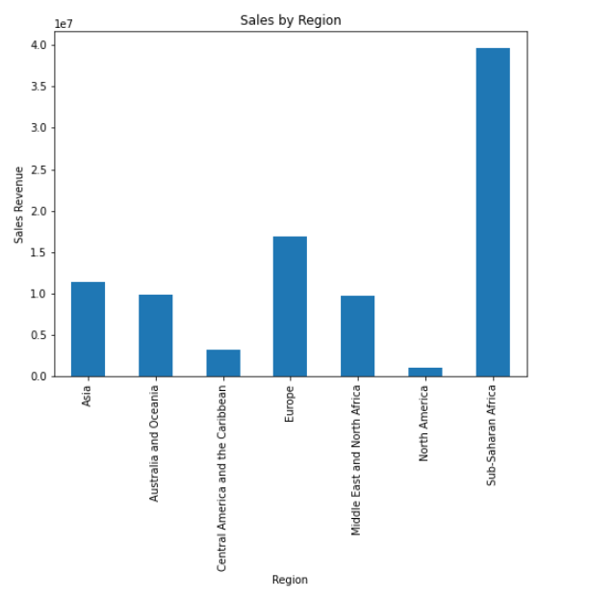
2. Stacked Bar Chart for Sales by Region
This chart shows the sales revenue by region, with each region represented by a
different color in a stacked bar chart. The chart will have the total sales revenue
displayed on the y-axis and the regions on the x-axis. The title of the chart will be
"Sales by Region."

Slide 5
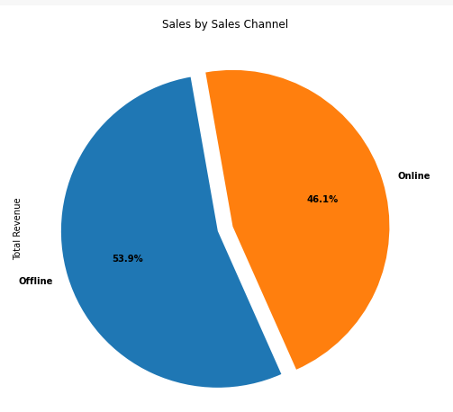
3. Pie Chart for Sales by Sales Channel
This chart shows the percentage of sales revenue by sales channel in a pie chart. Each
sales channel will be represented by a different slice of the pie chart, with the
percentage and sales revenue amount displayed in each slice. The title of the chart will
be "Sales by Sales Channel."

Slide 6
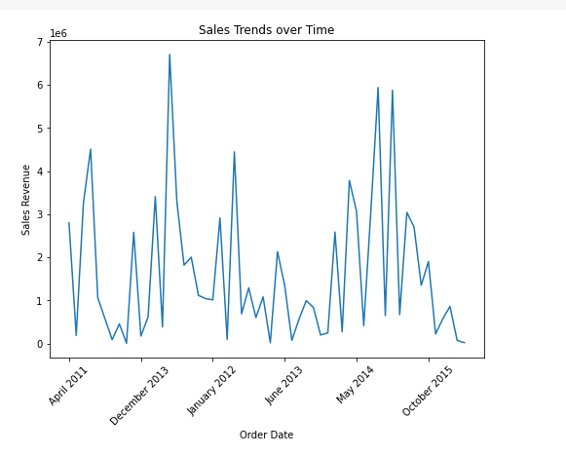
4: Line chart for sales trends over time
This chart shows the sales revenue trends over time, with each month represented on
the x-axis and the total sales revenue on the y-axis. The title of the chart will be "Sales
Trends over Time."

Slide 7
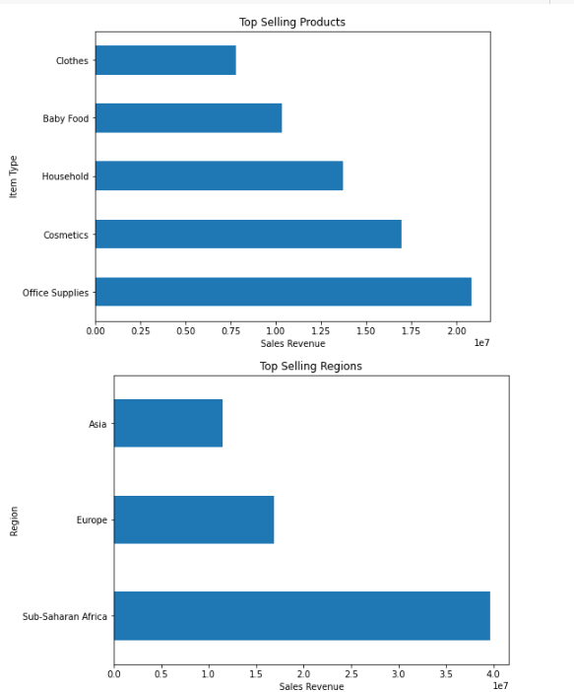
5: Horizontal bar chart for top-selling products and regions
This chart shows the top-selling products and regions by sales revenue in a horizontal
bar chart. The chart will have the products/regions displayed on the y-axis and the
sales revenue on the x-axis. The title of the chart will be "Top Selling
Products/Regions."

Slide 8
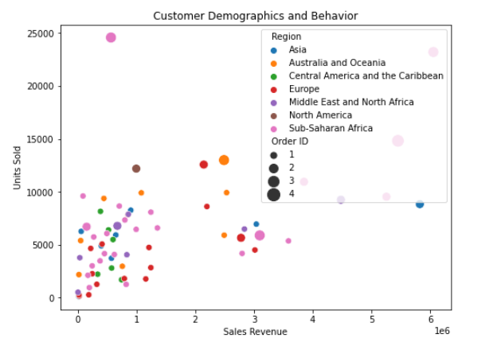
6: Bubble chart for customer demographics and behavior
This chart shows the customer demographics and behavior in a bubble chart. Each
bubble will represent a different region and country, with the size of the bubble
representing the number of orders and the color representing the region. The x-axis
will represent the total sales revenue, and the y-axis will represent the units sold. The
title of the chart will be "Customer Demographics and Behavior."

Slide 9
Conclusion
In conclusion, this project analyzed Amazon's sales data to identify trends, patterns, and insights that could help the company make data-driven decisions. The analysis showed that the majority of sales come from the United States, with the technology item type being the most popular among customers.
The sales by region analysis revealed that the largest revenue comes from the Asia Pacific region, while sales by sales channel showed that online sales generate the highest revenue. Additionally, the analysis of sales trends over time showed an overall upward trend in revenue, with a peak in December.
Based on the insights gained from the analysis, several recommendations were made to optimize sales, reduce costs, and improve customer satisfaction. These recommendations included expanding Amazon's reach in the Asia Pacific region, increasing investment in the technology item type, improving the online shopping experience, and optimizing pricing strategies.
Overall, this project demonstrated the power of data analysis in providing valuable insights for businesses like Amazon. By leveraging data-driven insights, Amazon can make informed decisions to improve its sales performance and customer satisfaction, ultimately leading to increased profitability and growth.

